Slide 1

Offline Water Conservation
An Open Source Project by RAM
Ray Lin, Mario Goranov, and Anish Muthali
Notes:
Hello. During this hackathon, we created the “Offline Water Conservation” project, an open source project by Team RAM, consisting of Ray, Anish, and Mario.

Slide 2



Problem
Information
Localization
Connectivity
Minimal usable data
Lack of granularity in data
Lack of access points
Notes:
When talking with a couple of farmers yesterday, we learned they would like to infer soil moisture content for watering certain crops. They face issues with data as there is not a large enough infrastructure for this. Because of this, they are unable to get properly localized, granular data. Lastly, they are unable to get a good connection across a large quarter mile by quarter mile field.

Slide 3


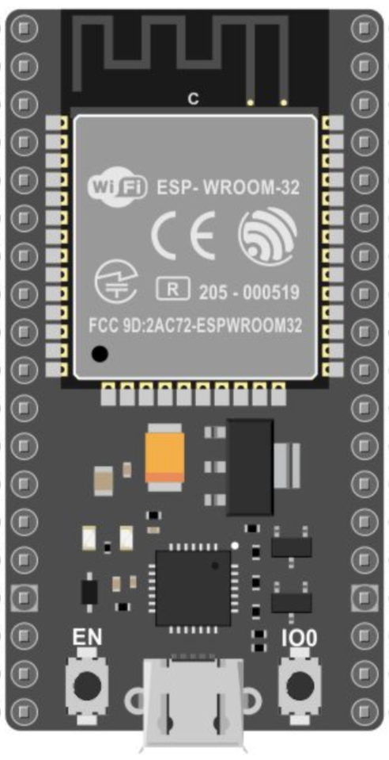


Open Source Solution
AI
Notes:
Our solution to this revolves around the ESP32, a WiFi enabled Arduino module that creates its own network. With this, a farmer is not only independent of farmhouse WiFi but is also able to scale his/her mesh network. Two raspberry pi’s gather data and passes it to another raspberry pi with an AI via the ESP32. In our case, we got temperature and precipitation data from the USDA. The AI infers a single number between 0 to 1, where 0 indicates “don’t water” and 1 indicates “water”.

Slide 4



Benefits
Plug and Play
Cost
Scalability
Sensor attachment
Less than $50 for setup
Mesh networks
Notes:
We would like to make the AI training open source because each model is specialized to specific soil conditions. We would also like to build an intuitive frontend app and incorporate some APIs which would cut down on necessary infrastructure and train our model.

Slide 5



Future Additions
More Models
Compatibility
Data Mining
Crowdsourcing model development
IFTT
Weather stations
Weather API
Model improvement
Notes:
We would like to make the AI training open source because each model is specialized to specific soil conditions. We would also like to build an intuitive frontend app and incorporate some APIs which would cut down on necessary infrastructure and train our model.

Slide 6
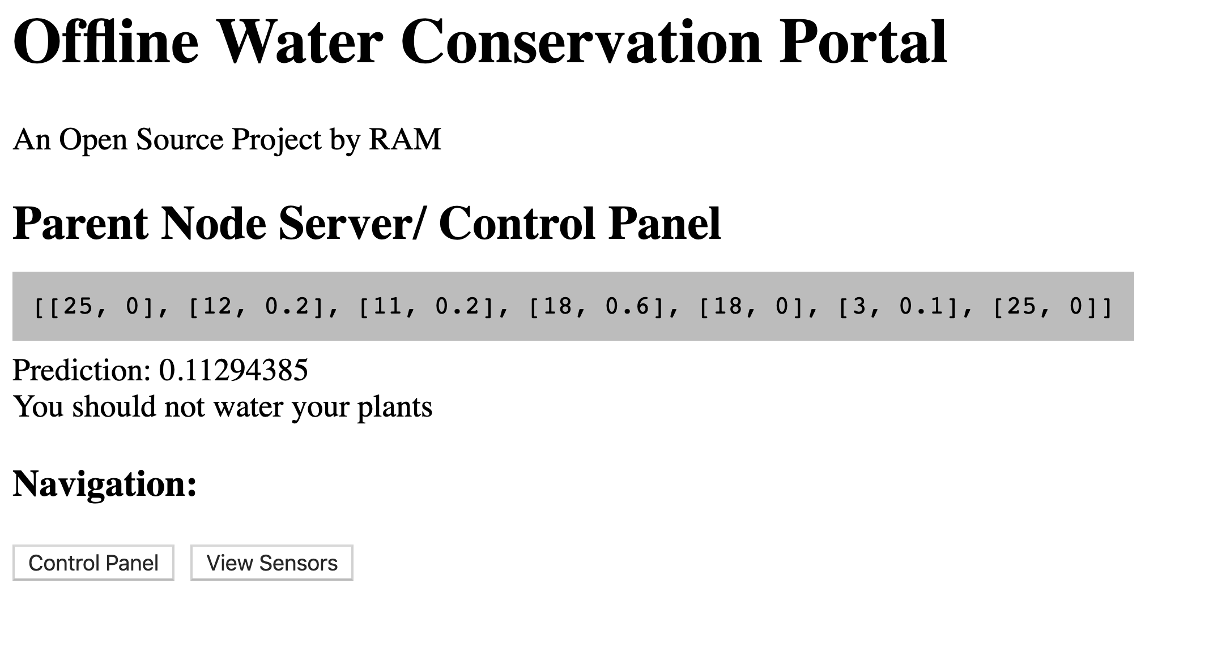

Slide 7
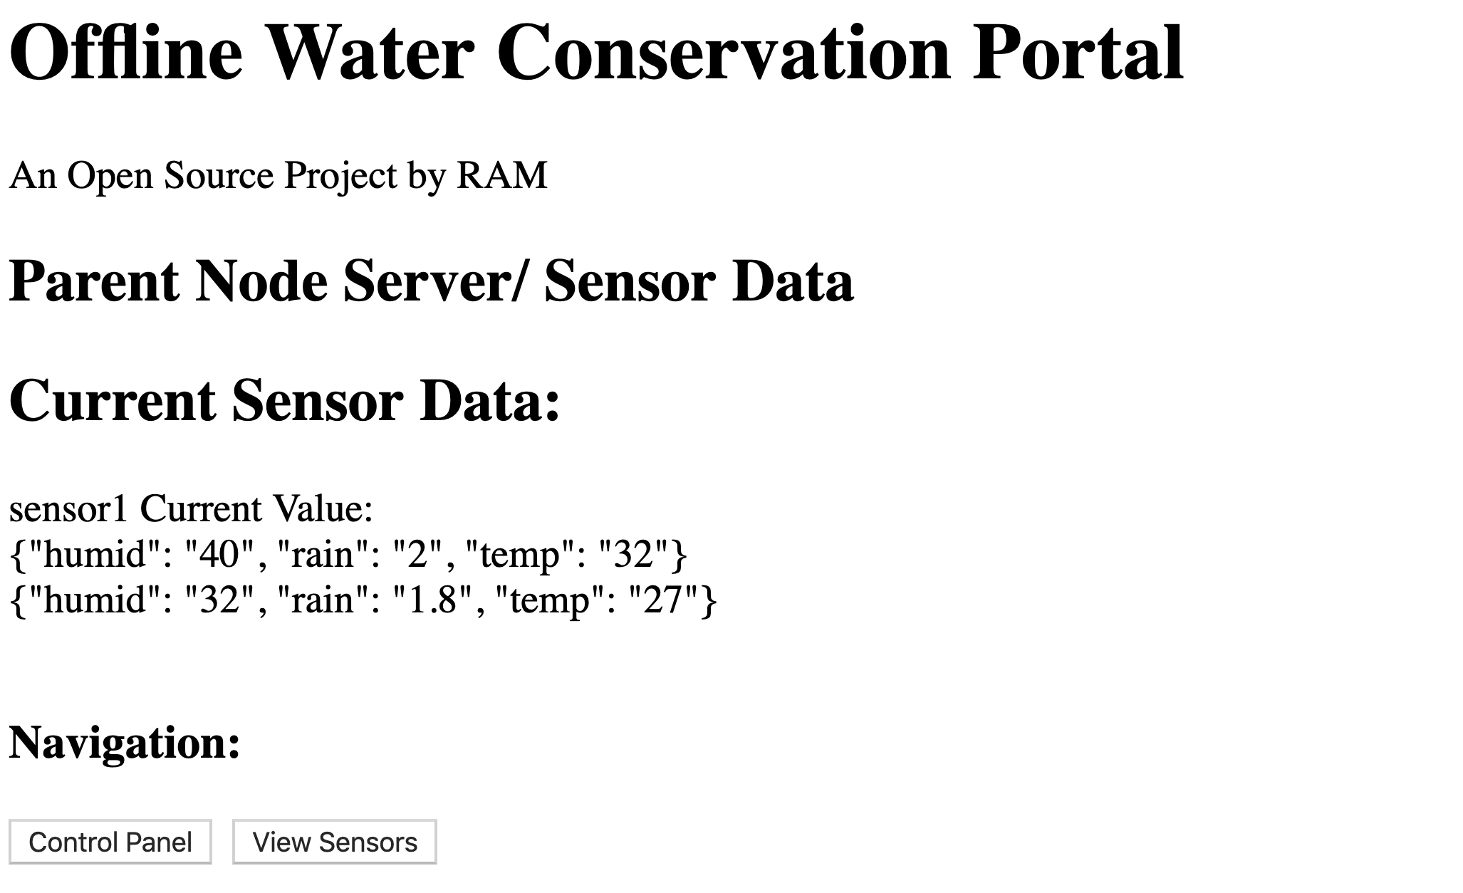

Slide 8
Demo and Q&A
Source code:
https://github.com/raylin01/iotworld2019

